Slide 1


An Empirical Testing of Autonomous Vehicle Simulator System for Urban Driving
John Seymour, Dac-Thanh-Chuong Ho, Quang-Hung Luu
Department of Computer Science and Software Engineering
Swinburne University of Technology, Australia

Slide 2
Introduction
Our work presents new empirical evidence that it is feasible to
Derive a good scenario diversity, and at the same time
Detect AV problems in the simulation environment.

Slide 3
questions
RQ1: Are our test cases effective in mimicking hazardous situations and can the system capture them?
RQ2: What are critical factors that distinguish a scenario to be safe or unsafe?
RQ3: Does the environmental condition have any impact on the safety of the AV?
RQ4: Is the use of simulator-based systems helpful in understanding safety in reality?

Slide 4
TESTING Method
Equivalence Partitioning
Metamorphic Testing

Slide 5
System under test
Apollo 6.0
SVL 2021.1

Slide 6
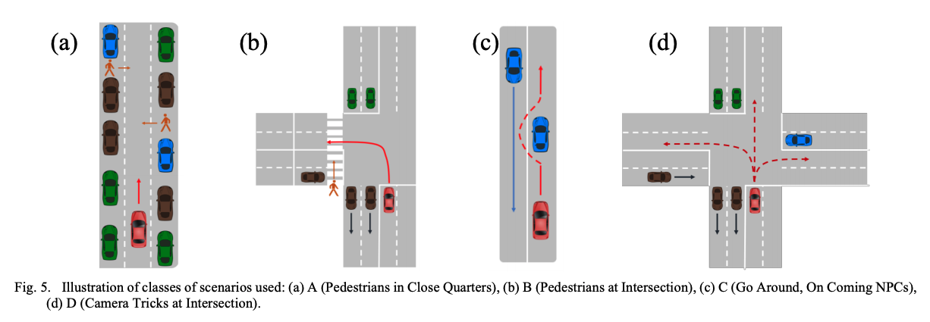
Test Scenarios

Slide 7
Test case execution & validation
Total test cases: 1062
For each scenario, we have coded a Python script and its associated Bash script to do automated testing.
For the metamorphic testing, we adopt two MRs, given a certain scenario during the daytime.
The condition in MR1 is that the AV decision is unchanged regardless of day or night-time.
For MR2, it requires the decision to be robust regardless of the time as well as the bad weather (intense rain and fog).

Slide 8
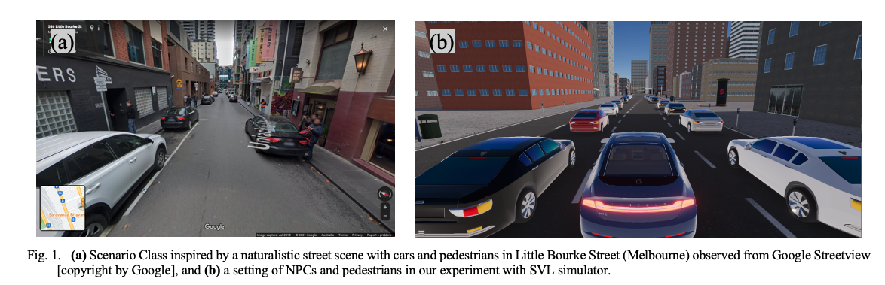
81 Tests for Scenario class A

Slide 9
Class A – Close Quarters
AV drives between a line of parked cars, pedestrians suddenly cross its path ahead
Scenario parameters:
General weather and time of day
Pedestrian speed
Pedestrian trigger distance
Number of parked cars
Pedestrian idle time
Pedestrian location among parked cars
Issues found:
AV fails to stop in time in some circumstances and occasionally doesn’t approach slow enough

Slide 10
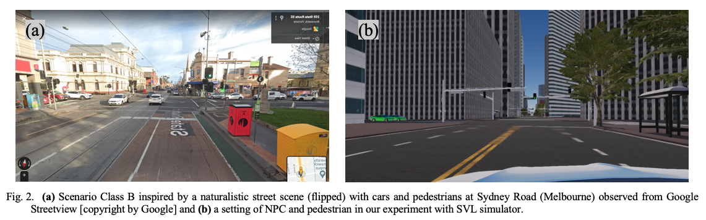
216 Tests for Scenario class B

Slide 11
Class B – Pedestrian Intersection
AV makes a right turn at an intersection. Pedestrian encroaches on its right of way where it is trying to turn to.
Scenario parameters:
General weather and time of day
Pedestrian speed
Pedestrian trigger distance
Pedestrian spawn distance from curb
Issues found:
AV sometimes does not slow down enough before letting the pedestrian pass

Slide 12
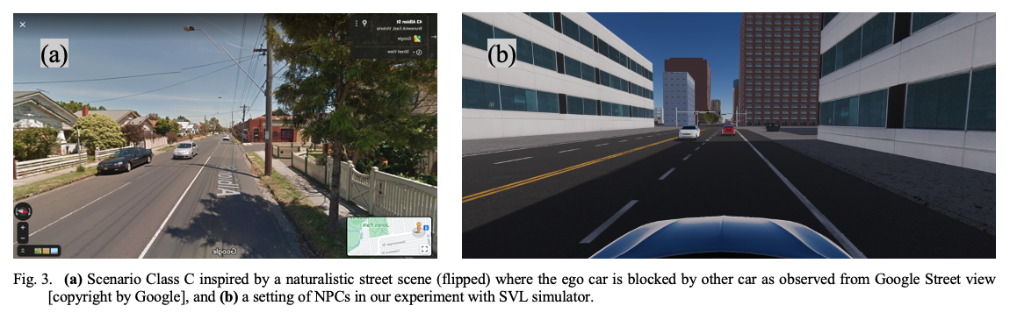
36 Tests for Scenario class C

Slide 13
Class C – Go around, Oncoming
AV attempts to encroach onto the other side of the road to get around a stationary NPC in its way. However, another NPC is oncoming and approaching it.
Scenario parameters:
General weather and time of day
Oncoming NPC speed
Oncoming NPC trigger distance
Oncoming NPC spawn distance
Issues found:
None; Ego vehicle does not ever encroach to the other side of the road, regardless of the presence of an oncoming vehicle

Slide 14
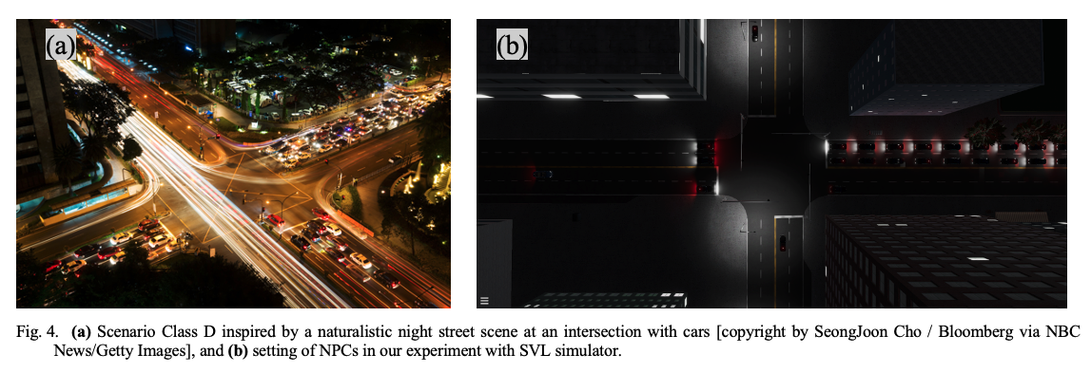
243 Tests for Scenario class D

Slide 15
Class D – Camera Tricks
AV navigates a crowded 4-way intersection with right of way, however, two perpendicular NPC cars enter the intersection as well, encroaching into its path.
Scenario parameters:
General weather and time of day
Left-side NPC speed
Left-side NPC trigger distance
Right-side NPC speed
Right-side NPC trigger distance
Ego vehicle turn direction (straight ahead, left turn, right turn)
RGB values for NPC vehicles (used for testing the camera module, if enabled in future)
Issues found:
AV fails to stop or even slow down in time, especially when driving straight ahead, sometimes colliding side on to an NPC
AV sometimes collides during turns as well
Large inconsistencies in AV behaviour for same scenario parameters

Slide 16
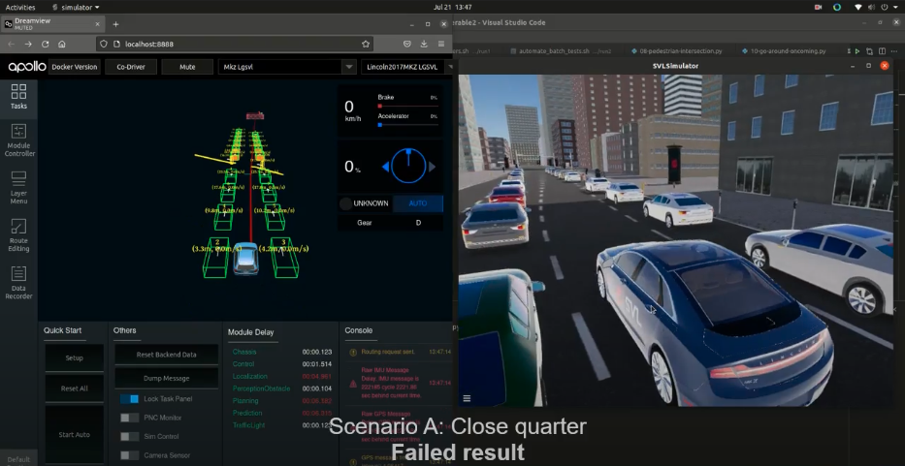
Video
The demo videos for all scenarios.
Due to limited space in GitHub, we have share the link here https://drive.google.com/drive/folders/1MKih9T7vX3yiayxU_tqrJmGoZ6L8Yzu6?usp=sharing

Slide 17
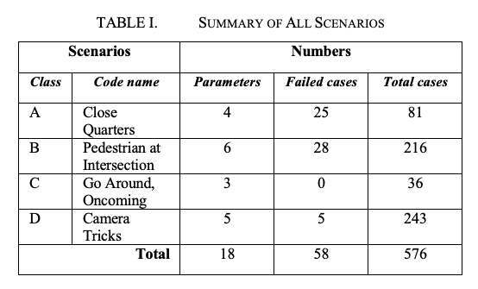
RQ1: Are our test cases effective in mimicking hazardous situations and can the system capture them?

Slide 18
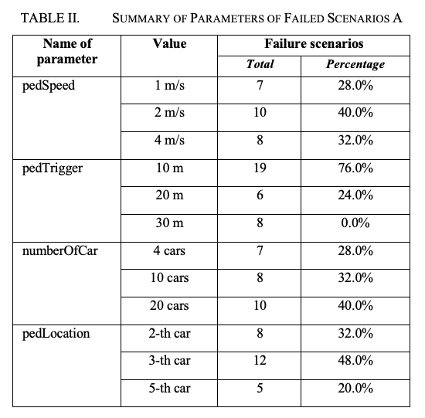
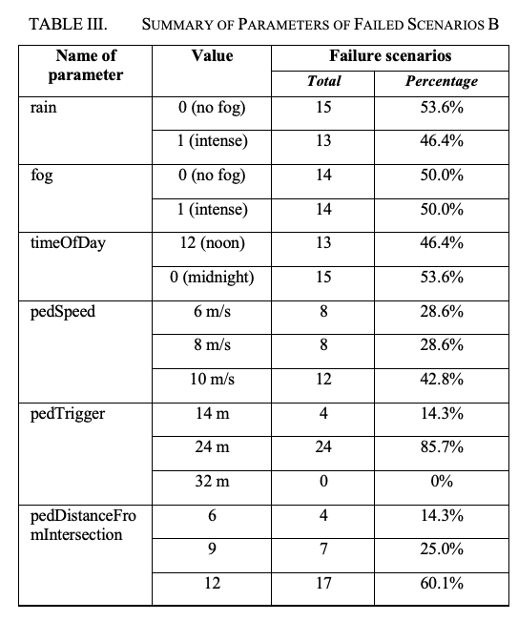
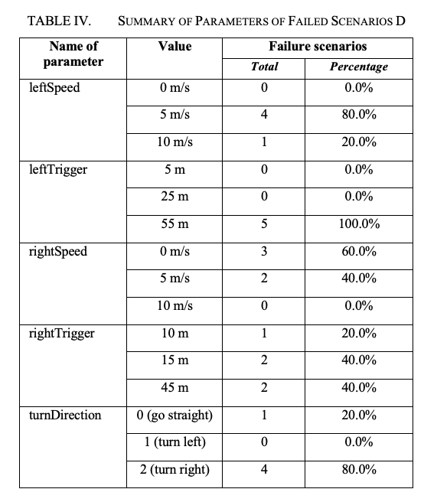
RQ2: What are critical factors that distinguish a scenario to be safe or unsafe?

Slide 19
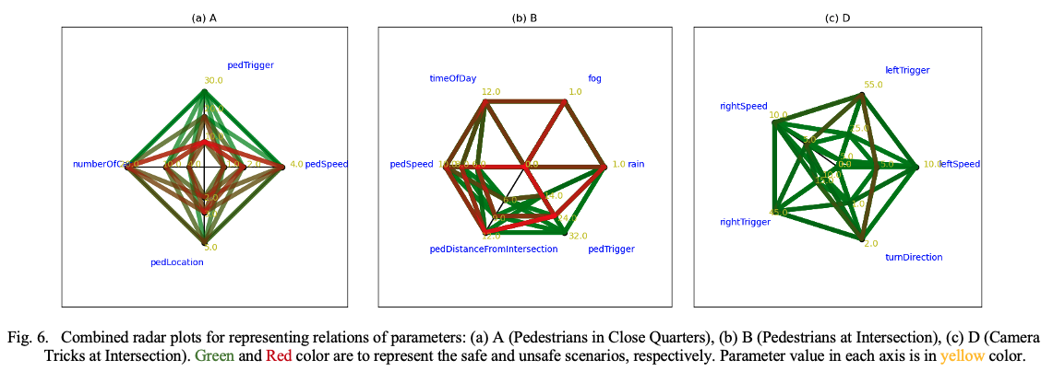
RQ2: What are critical factors that distinguish a scenario to be safe or unsafe? (2)

Slide 20
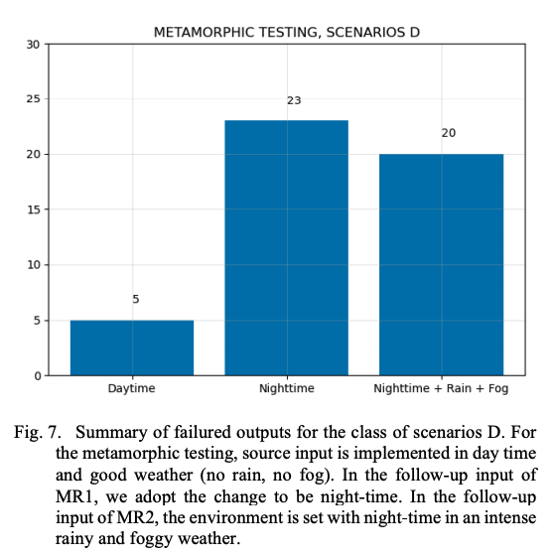
RQ3: Does the environmental condition have any impact on safety?

Slide 21
RQ4: Is the use of simulator-based systems helpful in understanding the safety of AVs in reality?
Our study demonstrates that the effectiveness of the SVL in simulating the driving scenarios are close to human intuition.
Weather and light condition do have an impact on safety.
It is reported in our study that collisions occur in 10% of all tested scenarios, double the ratio by human driving. Considering that there are many millions of people involved in the traffic every day, this ratio is large.

Slide 22
ANSWERS TO RQ
Answer to RQ1: The setup scenarios are effective in mimicking real-life situations; and at the same time, the system can capture collisions well.
Answer to RQ2: There are several critical factors distinguishing a scenario to be safe or unsafe.
Answer to RQ3: The environmental conditions do have an impact on the safety of AVs.
Answer to RQ4: The use of simulator-based system helps understand the safety in reality.

Slide 23
Remarks
Our study provides a new empirical evidence to support the argument that AV simulator systems can well represent real-life scenarios.
If the system performs similarly in reality, our study implies that state-of-the-art AVs should be tested thoroughly before deployment to reduce safety-critical problems.

